Slide 1
Data Persistence
Session 7
Course : Mobile Community Solution
Effective Period : September 2019

Slide 2
Learning Objectives
At the end of this meeting is expected that students will be able to:
  Describe the main features of Android Programming and Android Software Development
  Produce simple Mobile Application using the main features of Android

Slide 3

Contents
Persisting Data to File
Saving to Internal Storage
Saving to External Storage
Creating and Using Database

Slide 4
Persisting Data to File
Android provides several options for you to save persistent application data.
The solution you choose depends on your specific needs, such as whether the data should be private to your application or accessible to other applications (and the user) and how much space your data requires.
Your data storage options are the following:
  Shared Preferences Store private primitive data in key-value pairs.
  Internal Storage Store private data on the device memory.
  External Storage Store public data on the shared external storage.
  SQLite Databases Store structured data in a private database.
  Network Connection Store data on the web with your own network server.

Slide 5

Persisting Data to File
The SharedPreferences class provides a general framework that allows you to save and retrieve persistent key-value pairs of primitive data types.
The SharedPreferences object enables you to store data that is best stored as name/value pairs —for example, user ID, birth date, gender, driving license number, and so on.
However, sometimes you might prefer to use the traditional file system to store your data.
For example, you might want to store the text of poems you want to display in your applications.
In Android, you can use the classes in the java.io package to do so.

Slide 6
Saving to Internal Storage
You can save files directly on the device's internal storage.
By default, files saved to the internal storage are private to your application and other applications cannot access them (nor can the user).
When the user uninstalls your application, these files are removed.
To create and write a private file to the internal storage:
  Call openFileOutput() with the name of the file and the operating mode. This returns a FileOutputStream.
  Write to the file with write().
  Close the stream with close().

Slide 7
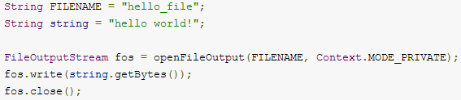
Saving to Internal Storage
For Example:
MODE_PRIVATE will create the file (or replace a file of the same name) and make it private to your application.
Other modes available are: MODE_APPEND, MODE_WORLD_READABLE, and MODE_WORLD_WRITEABLE.
To read a file from internal storage:
  Call openFileInput() and pass it the name of the file to read. This returns a FileInputStream.
  Read bytes from the file with read().
  Then close the stream with close().
  Tip: If you want to save a static file in your application at compile time, save the file in your project res/raw/directory.
  You can open it with openRawResource(), passing the R.raw.<filename> resource ID. This method returns an InputStream that you can use to read the file (but you cannot write to the original file).

Slide 8
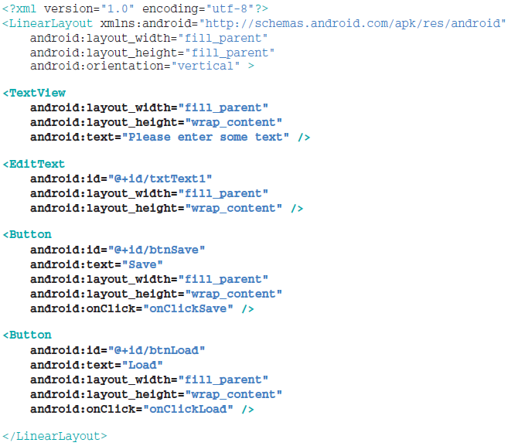
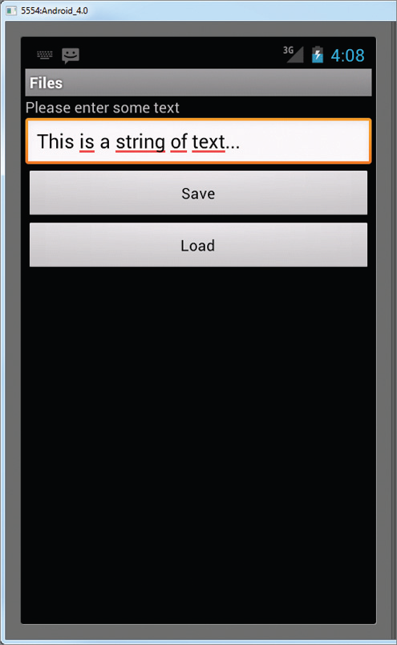
Example
Create an android project and name it File
In the main.xml file, add the following statements in bold:

Slide 9
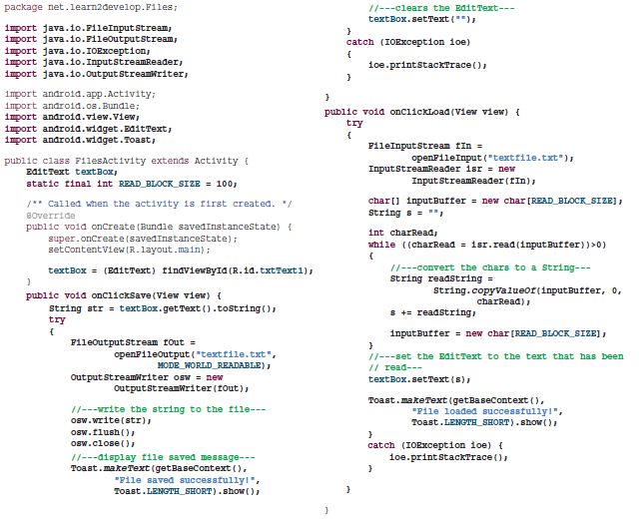
In the
FilesActivity.java file, add the following statements in bold:

Slide 10
Example
Type some text into the EditText view and then click the Save button.
If the file is saved successfully, you will see the Toast class displaying the “File saved successfully!” message.
The text in the EditText view should disappear.
Click the Load button and you should see the string appearing in the EditText view again.
This confirms that the text is saved correctly.
The Result:open the project explorer and there is a file call textfile.txt

Slide 11
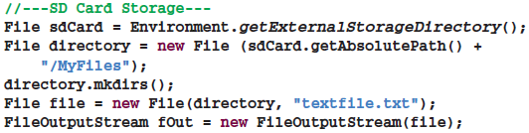
Saving to External Storage
The previous section showed how you can save your files to the internal storage of your Android device.
Sometimes, it would be useful to save them to external storage (such as an SD card) because of its larger capacity, as well as the capability to share the fi les easily with other users (by removing the SD card and passing it to somebody else).
Using the project created in the previous section as the example, to save the text entered by the user in the SD card, modify the onClick() method of the Save button as shown in bold here:

Slide 12
Saving to External Storage
The preceding code uses the getExternalStorageDirectory() method to return the full path to the external storage. Typically, it should return the “/sdcard” path for a real device, and “/mnt/sdcard” for an Android emulator.
However, you should never try to hardcode the path to the SD card, as manufacturers may choose to assign a different path name to the SD card. Hence, be sure to use the getExternalStorageDirectory() method to return the full path to the SD card.
You then create a directory called MyFiles in the SD card.
Finally, you save the file into this directory.

Slide 13
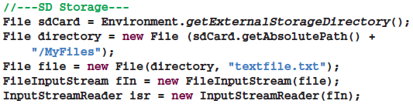
Saving to External Storage
To load the file from the external storage, modify the onClickLoad() method for the Load button:
Note that in order to write to the external storage, you need to add the WRITE_EXTERNAL_STORAGE permission in your AndroidManifest.xml file:
If you run the preceding modifi ed code, you will see the text file created in the /mnt/sdcard/MyFiles/ folder

Slide 14
Using Static Resource
Besides creating and using files dynamically during runtime, it is also possible to add files to your package during design time so that you can use it during runtime.
For example, you may want to bundle some help files with your package so that you can display some help messages when users need them.
In this case, you can add the files to your package’s res/raw folder (you need to create this folder yourself).
the res/raw folder containing a file named textfile.txt.

Slide 15
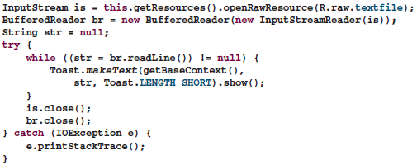
Using Static Resource
To make use of the file in code, use the getResources() method (of the Activity class) to return a Resources object, and then use its openRawResource() method to open the file contained in the res/raw folder:
The resource ID of the resource stored in the res/raw folder is named after its filename without its extension.
For example, if the text file is textfile.txt, then its resource ID is R.raw.textfile.

Slide 16
Creating and Using Databases
So far, all the techniques you have seen are useful for saving simple sets of data. For saving relational data, using a database is much more efficient.
For example, if you want to store the test results of all the students in a school, it is much more efficient to use a database to represent them because you can use database querying to retrieve the results of specific students.
Moreover, using databases enables you to enforce data integrity by specifying the relationships between different sets of data.
Android uses the SQLite database system.
The database that you create for an application is only accessible to itself; other applications will not be able to access it.

Slide 17
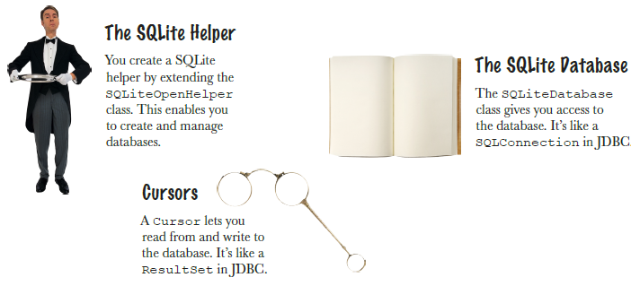
Android comes with SQLite classes
Android uses a set of classes that allows you to manage a SQLite database. There are three types of object that do the bulk of this work.

Slide 18
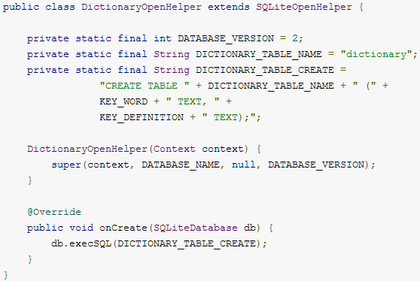
Creating and Using Databases
For Example:
You can then get an instance of your SQLiteOpenHelper implementation using the constructor you've defined.
To write to and read from the database, call getWritableDatabase() and getReadableDatabase(), respectively.
These both return a SQLiteDatabase object that represents the database and provides methods for SQLite operations.

Slide 19
Creating and Using Databases
You can execute SQLite queries using the SQLiteDatabase query() methods, which accept various query parameters, such as the table to query, the projection, selection, columns, grouping, and others.
For complex queries, such as those that require column aliases, you should use SQLiteQueryBuilder, which provides several convienent methods for building queries.
Every SQLite query will return a Cursor that points to all the rows found by the query.
The Cursor is always the mechanism with which you can navigate results from a database query and read rows and columns.

Slide 20
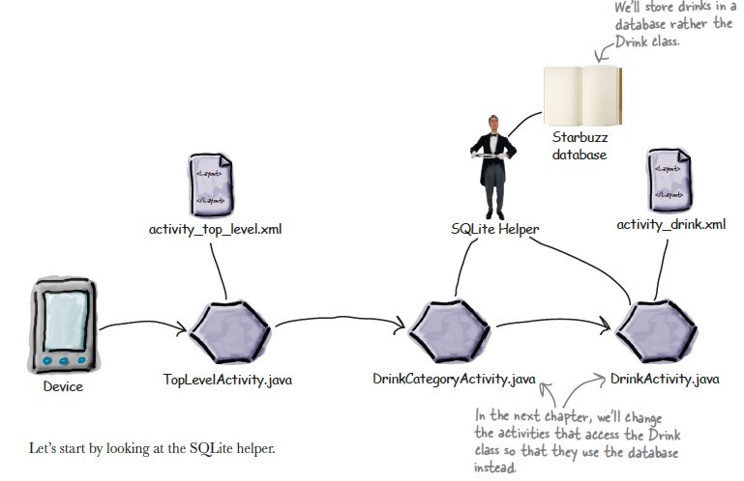
Example – Starbuzz App
We’ll change the app to use a database
  Create the Database
  Create the Drink table and populate it with drinks.

Slide 21
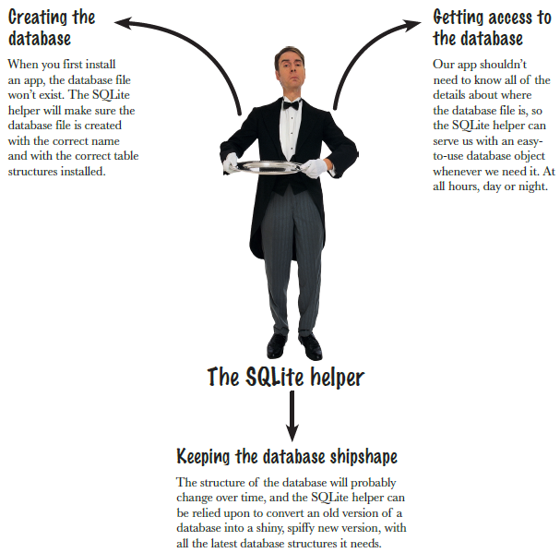
The SQLite Helper

Slide 22
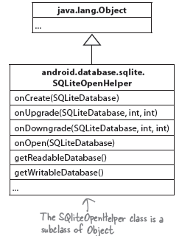
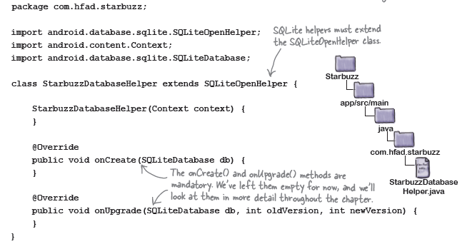
Create the SQLite Helper
The onCreate() method gets called when the database first gets created on the device.
The onUpgrade() method gets called when the database needs to be upgraded.

Slide 23
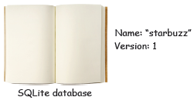
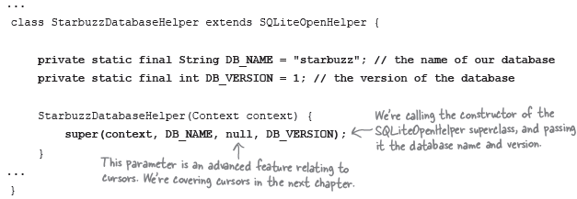
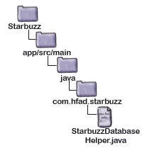
1. Specify the database
There are two pieces of information the SQLite helper needs in order to create the database:
  First, we need to give the database a name.
  The second piece of information we need to provide is the version of the database.

Slide 24
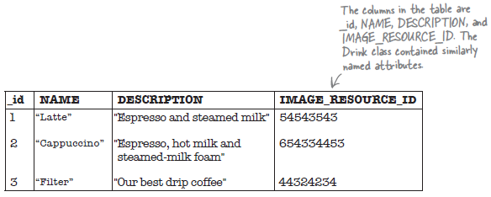
Inside a SQLite database
The data inside a SQLite database is stored in tables. A table contains several rows, and each row is split into columns. A column contains a single piece of data, like a number of a piece of text.
It’s an Android convention to call your primary key columns _id. Android code expects there to be an _id column on your data. Ignoring this convention will make it harder to get the data out of your database and into your user interface.
Storage classes and data-types:
  INTEGER
  TEXT
  REAL
  NUMERIC
  BLOB

Slide 25
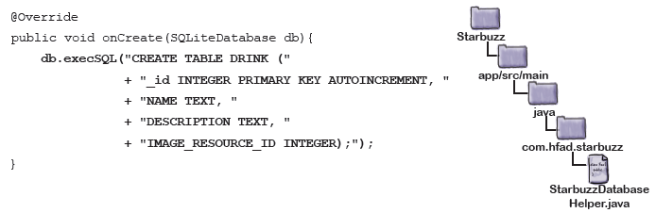
The onCreate() method is called when the database is created
The SQLiteDatabase class gives you access to the database
The onCreate() method is passed a SQLiteDatabase object as a parameter. We can use this to run our SQL command with the method:

Slide 26
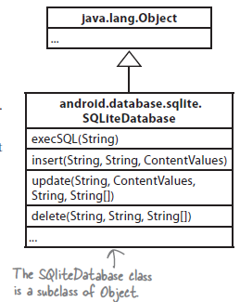
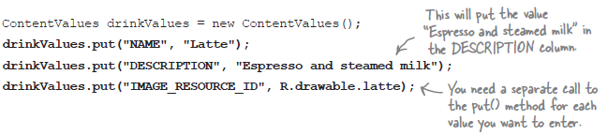
Insert data using the insert() method
If you need to prepopulate a SQLite table with data, you can use the SQLiteDatabase insert() method.
You add name/value pairs of data to the ContentValues object using its put() method.

Slide 27

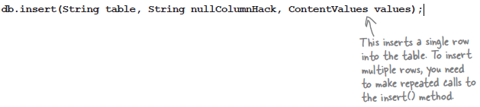
Insert data using the insert() method
Finally, we’ll use the SQLiteDatabase insert() method to insert the values into the DRINK table:
db.insert("DRINK", null, drinkValues);
Running these lines of code will insert the Latte record into the DRINK table:
The insert() method takes the following general form:

Slide 28

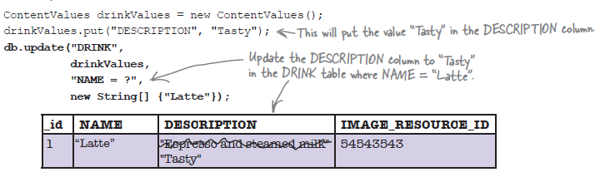
Update records with the update() method
To use the update() method, you need to specify the table you want to update records in, the values you want to update, and the conditions for updating them. Here’s what it looks like:
Example:

Slide 29


Multiple Condition
here’s how you’d update records from the DRINK table where the name of the drink is “Latte”, or the drink description is “Our best drip coffee”.
As an example, here’s how you’d return DRINK records where the _id is 1:

Slide 30

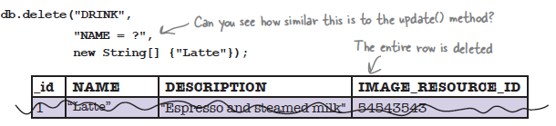
Delete records with the delete() method
The SQLiteDatabase delete() method works in a similar way to the update() method you’ve just seen.
For Example:

Slide 31
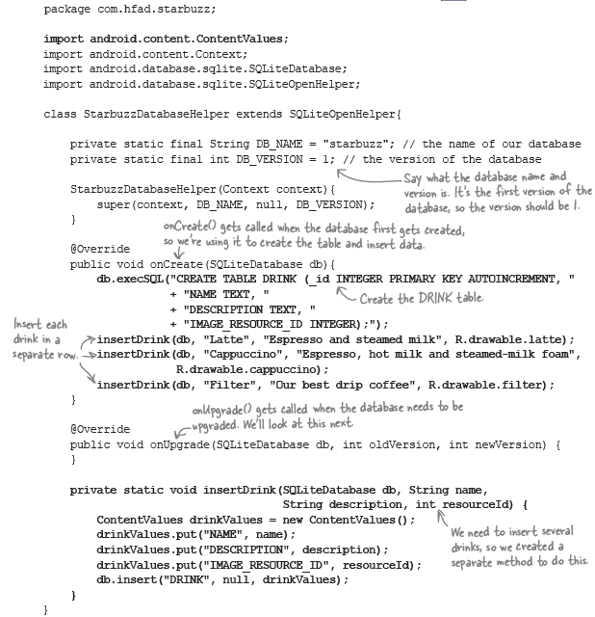
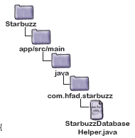
The StarbuzzDatabaseHelper code

Slide 32
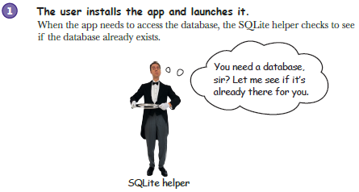
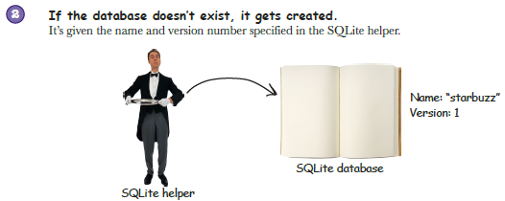
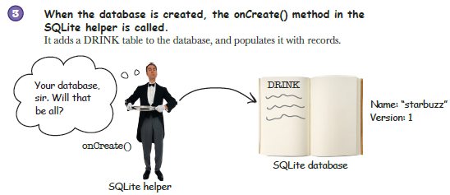
What the SQLite helper code does

Slide 33
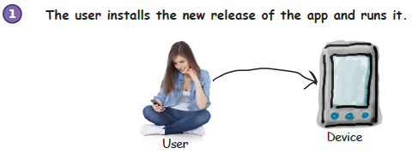
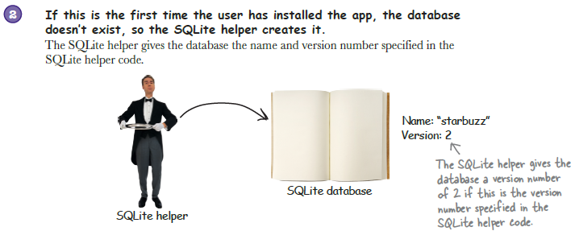
Upgrading the database: an overview

Slide 34
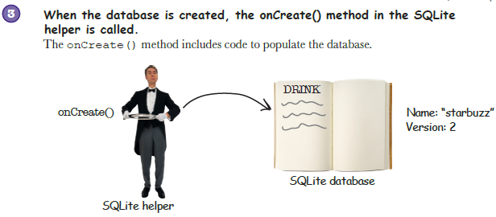
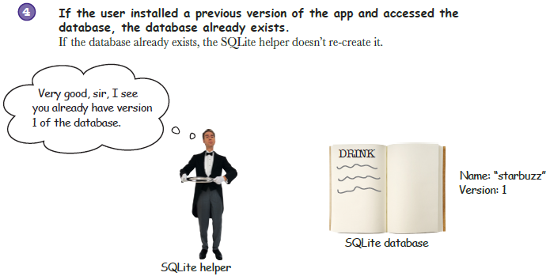
Upgrading the database: an overview

Slide 35
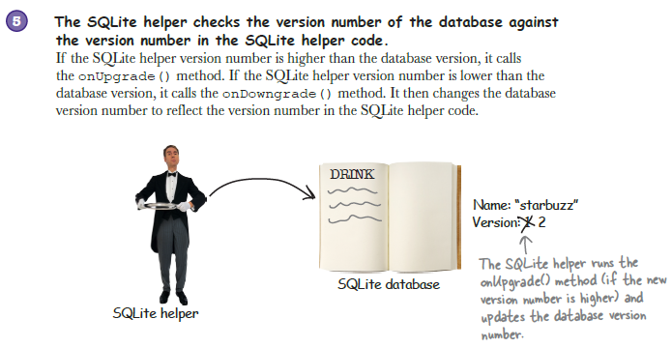
Upgrading the database: an overview

Slide 36
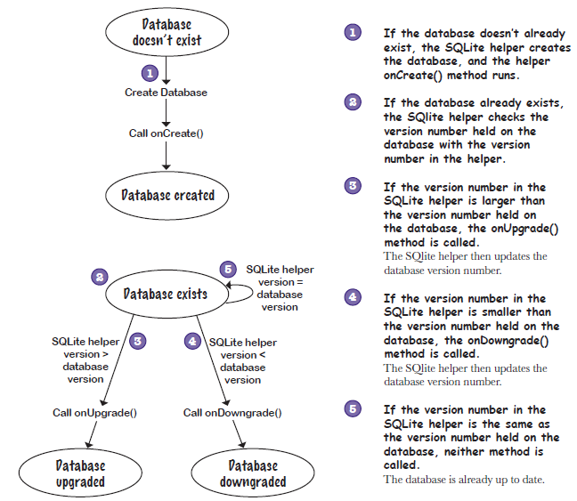
How the SQLite helper makes decisions

Slide 37
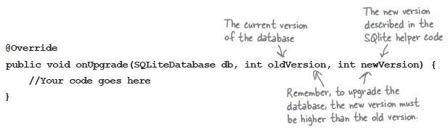
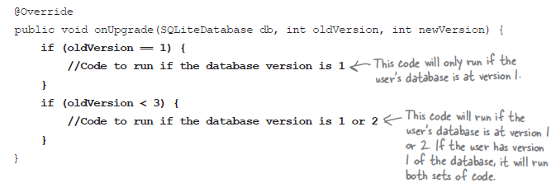
Upgrade your database with onUpgrade()
The onUpgrade() method has three parameters—the SQLite database, the version number of the database itself, and the new version of the database that’s passed to the SQLiteOpenHelper superclass:
Example:

Slide 38
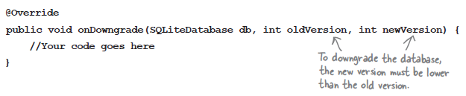
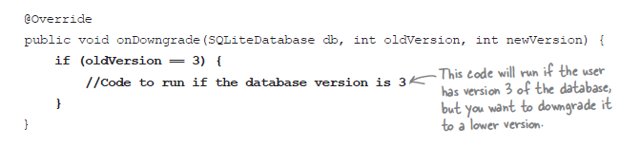
Downgrade your database with onDowngrade()
The onDowngrade() method is used to revert your database to a previous version.
Example:

Slide 39
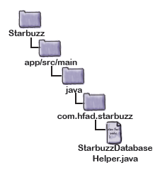
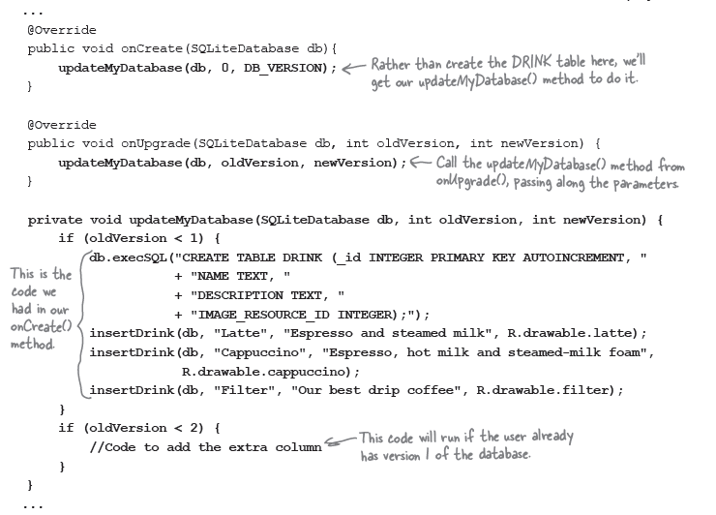
Let’s upgrade the database

Slide 40
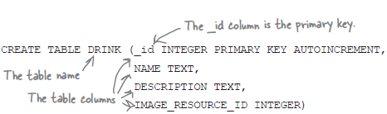

Add new columns to tables using SQL
how you could create tables using the SQL CREATE TABLE command like this:
You can also use SQL to change an existing table using the ALTER TABLE command. As an example, here’s what the command looks like to add a column to a table:

Slide 41


Renaming Tables
You can also use the ALTER TABLE command to rename a table. As an example, here’s how you’d rename the DRINK table to FOO:
Delete tables by dropping them:
Execute the SQL using execSQL()

Slide 42
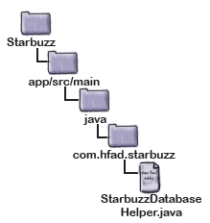
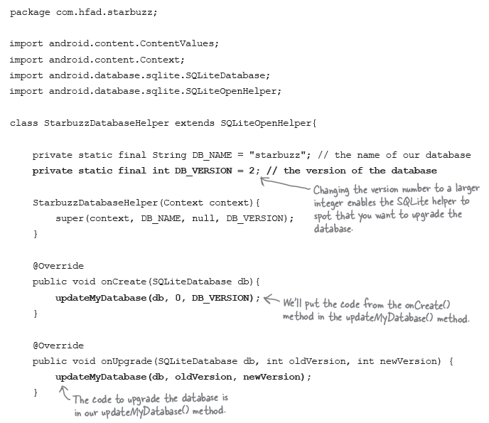
The full SQLite helper code
Continue ->

Slide 43
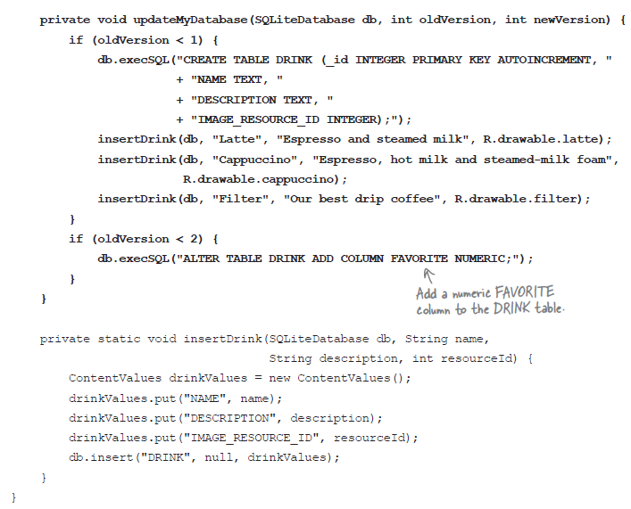
The full SQLite helper code (Cont.)

Slide 44
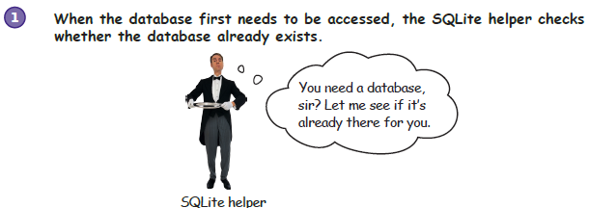
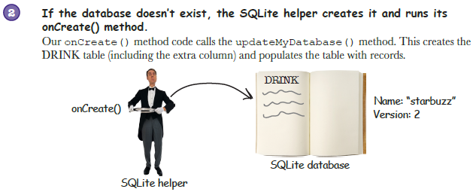
What Happens when the code run

Slide 45
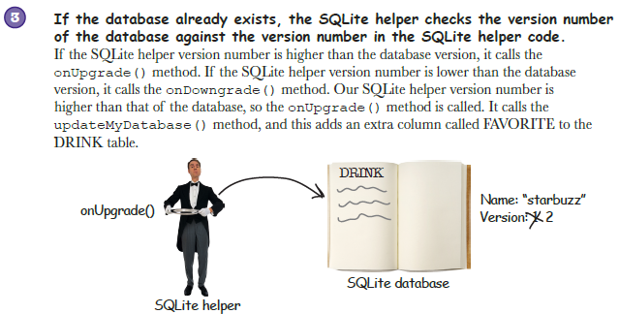
What Happens when the code run (Cont.)

Slide 46
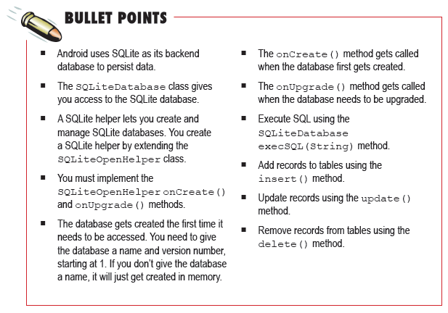
Summary

Slide 47
References
Head First Android Development. A Brain friendy guide. Dawn Griffiths and David Griffiths.O’reilly. ISBN:978-1-449-36218-8. Chapter 11

